Slide 1
SEP490 CAPSTONE REVIEW 2 • FA26SE309 • GFA26SE173 • 05/11/2026
PhysLive: Interactive Physics Simulation Platform
B2B SaaS for GDPT 2018 with Automated Physics Law Verification & LLM Self-Repair Loop
Supervisor: M.Sc. Nguyen Tan Phuc
Nguyen Hoang Bao Viet
Tran Bao Minh
Nguyen The Hung
Vo Tran Tuan Kiet
SE183457 • Leader & AI Architect
SE184103 • Fullstack & RK4 Solver
SE183807 • BA/QA & B2B Ops
SE182808 • Fullstack & Reviewer

Slide 2
01 / PROBLEM STATEMENT
Context & Core Challenges
Lab Equipment Deficit
Rigid Legacy Tools
High funding barriers for standard school labs.
PhET lacks custom textbook problem generation.
LLM Physics Hallucination
The PhysLive Solution
Raw AI violates energy conservation laws.
Instant OCR-to-2D simulation with law verification.

Slide 3
02 / ACCESS CONTROL
Unified 7-Role RBAC Architecture
Role Code | Actor Title | Core Platform Responsibilities
GUEST | Public Visitor | Explore public library, register school tenant
STUDENT | High School Student | Run interactive labs, submit POE predictions
STAFF | Physics Teacher | Upload OCR problems, configure sims, grade works
SCHOOL | School Administrator | Manage classes, assign teachers, import CSV rosters
REVIEWER | Pedagogical Specialist | Audit curriculum alignment, approve public library
MANAGER | B2B Platform Ops | Manage partner tenants, AI token quotas, VNPAY revenue
ADMIN | Super Administrator | System-wide security auditing, manager provisioning

Slide 4


03 / SCIENTIFIC ENGINE
Physics Verification & LLM Self-Repair
1. Adaptive RK4 Numerical Solver
Adaptive sub-stepping eliminates Euler energy drift.
CONSERVATION INVARIANT
2. SI Dimensional AST Analysis
Bounded AST checks international unit dimensions.
Dimensional Basis Verification
3. Automated LLM Self-Repair Loop
Refines FLAGGED parameters until VERIFIED_BY_LAWS.

Slide 5
04 / SYSTEM ARCHITECTURE
Dual-Runtime Execution Architecture
CLIENT-SIDE RUNTIME
SERVER-SIDE CERTIFICATION
equations.ts + Pixi.js v8
SchemaEquationRuntime.java
Zero Latency: 0ms local browser parameter updates.
Spring Boot Core: Independent single-pass verification run.
60 FPS Rendering: Hardware-accelerated WebGL/WebGPU canvas.
Anti-Tampering: Blocks client-side JavaScript manipulation.
Zero Bottleneck: Eliminates continuous server polling requests.
Official Seal: Certifies published lessons and exam submissions.

Slide 6
05 / B2B MONETIZATION & QUOTA ENGINE (DESIGNED BY HUNGNT)
B2B Billing, Atomic Quota & Resilience
STARTER • 30M VND
ADVANCED • 60M VND
ENTERPRISE • 120M VND
500 Students • 100K AI tokens/mo
1,500 Students • 300K AI tokens/mo
3,500 Students • 1M AI tokens/mo
VNPAY HMAC-SHA512
Atomic Row Locking
Graceful Exceptions
Automated IPN Server-to-Server webhook activation.
SELECT FOR UPDATE & REQUIRES_NEW stops race conditions.
REQUIRES_REVIEW alerts & SUSPENDED_READ_ONLY state.

Slide 7
06 / CURRICULUM ARCHITECTURE
GDPT 2018 Taxonomy & Bilingual JSONB
TIER 1
TIER 2
TIER 3
LEAF NODE
Topic
Module
Grade Level
Sim Lesson
Flyway V54 JSONB Localization
MVP Scope (Live Now)
Council 1.1–1.2 Expansion
localized_name: {"vi": "...", "en": "..."}
Mechanics & Direct Current Electricity
Harmonic Oscillation, Waves, Optics, Thermal

Slide 8
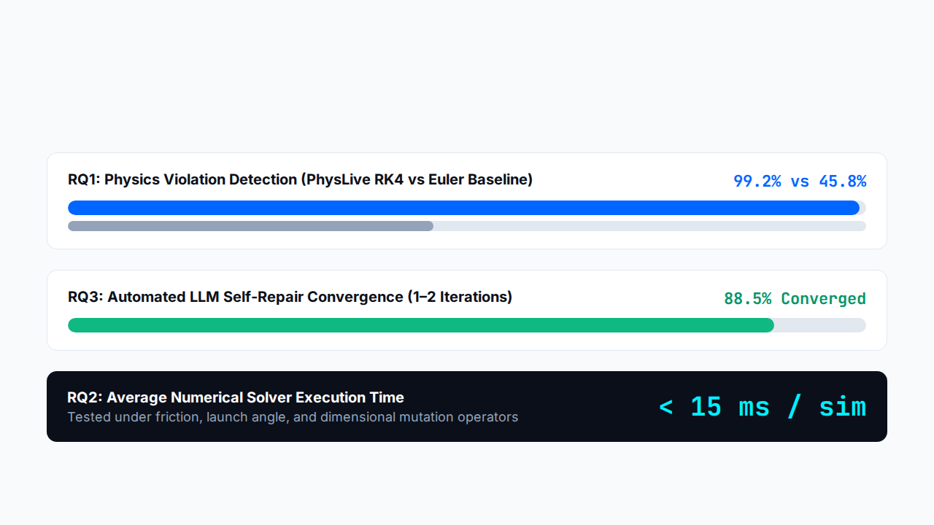
07 / EMPIRICAL RESEARCH BENCHMARK (100 GDPT 2018 PROBLEMS)
Mutation Testing & Research Questions (RQ1–RQ3)

Slide 9
08 / QUALITY ASSURANCE
Multi-Tier Testing & Verification Rigor
69
82%
3
JUnit 5 & Mockito Tests (100% Pass)
JaCoCo Code Coverage
Playwright 1.64.1 E2E Engines
Testcontainers 1.21.4: Isolated Docker PostgreSQL verifying tenant Row-Level Security (RLS).
Real Browsers: Automated auth, VNPAY billing, and admin verification on Chromium, Edge, WebKit.

Slide 10
09 / DEPLOYMENT & ROADMAP
Live Environment & Council 1.1 Roadmap
● LIVE SYSTEM HEALTH: UP
NEXT MILESTONE
Active Stack Infrastructure
Path to Defense Council 1.1
Spring Boot API: localhost:8080 (Actuator Health UP)
Student Analytics: Granular learning progress reports.
React 19 + Vite 7: localhost:5173 (HMR < 300ms)
Community Caching: High-speed public simulation cache.
Supabase Cloud DB: Flyway Migrations V1 to V55
Release Freeze: Baseline locked at Git Tag review-2.

Slide 11
10 / LIVE SYSTEM WALKTHROUGH
End-to-End Live Demonstration Flows
Flow 1: Teacher AI OCR & Law Certification
Upload textbook image ➔ AI parameter extraction ➔ RK4 solver check ➔ VERIFIED_BY_LAWS badge.
Flow 2: Student Interactive Pixi.js Lab & POE
Adjust 60 FPS canvas sliders ➔ Submit POE hypothesis ➔ Observe real-time mechanical energy graphs.
Flow 3: B2B Manager Quota, VNPAY & Exception Handling
Provision school quota ➔ Upgrade tier via VNPAY ➔ Reconcile revenue & enforce SUSPENDED_READ_ONLY.

Slide 12
TEAM FA26SE309 • SEP490 REVIEW 2
Thank You & Q&A
Special thanks to Supervisor M.Sc. Nguyen Tan Phuc and the Review Committee. We welcome your questions and feedback.

